Slide 1
ListIterator
Presented by: David Leblanc

Slide 2

Information
Iterate over collection without showing its internal structure
ListIterator is a subinterface of iterator
ListIterator normally support polymorphic iteration, that is it can iterate over any kind of collection

Slide 3
Internal ListIterator
Easier to implement
Only 1 iterator can exist at a time
Created as an inner class in collection class

Slide 4
External ListIterator
Harder to implement
Can have as many iterators as desired
Every iterator keeps track of its own state
Created as an outside class

Slide 5
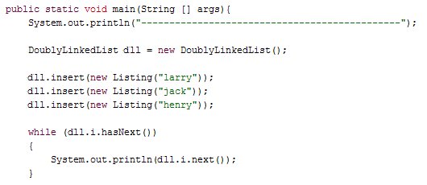

Example Internal ListIterator

Slide 6
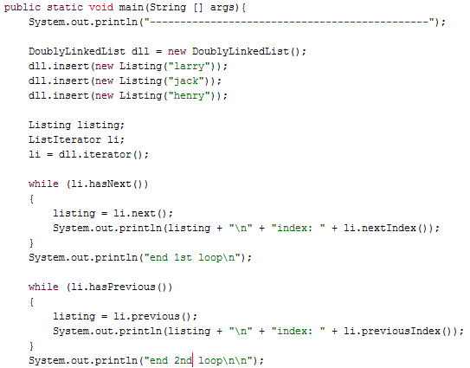
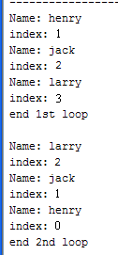
Example External ListIterator

